Slide 1
Data Visualization
Reproducible Data Visualization
Data Sciences Institute, University of Toronto

Slide 2
Today we’re going to...
Explore why reproducibility in data visualization matters
Understand why reproducible data visualization practices are both ethical and practical
Discuss practices we can implement to make our data visualizations reproducible

Slide 3
Case Study: Why should we care about reproducible data visualization?
Notes:
To start things off, we’ll look at an example of why reproducibility is so important to us as people who want to visualize data

Slide 4
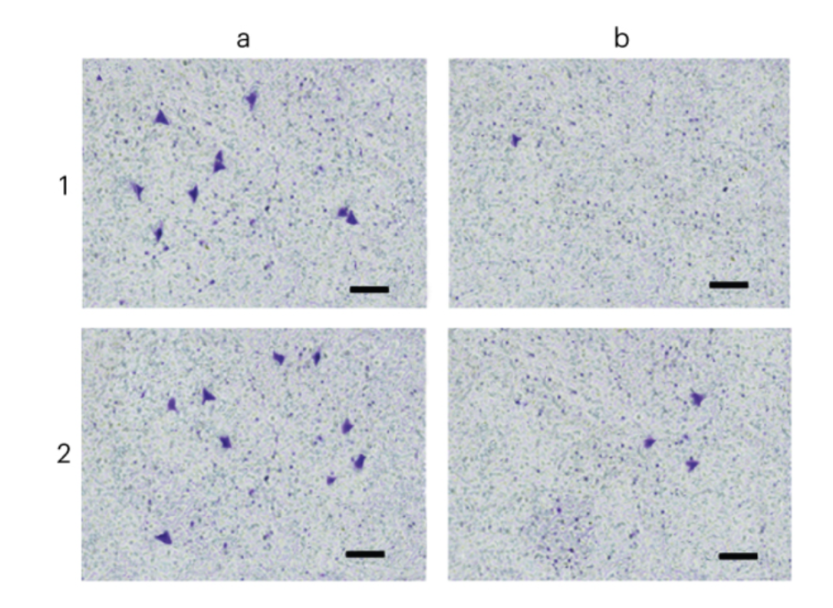
Image Manipulation
In 2016, a research article showing the effectiveness of a particular molecular compound as a potential cancer treatment was published
Cell staining images were used to support authors’ conclusions
(Shen, 2020)
Notes:
Referenced:
Shen, H. (2020). Meet this super-spotter of duplicated images in science papers. Nature, 581(7807), 132–136. https://doi.org/10.1038/d41586-020-01363-z

Slide 5
Image Manipulation
Dr. Elisabeth Bik, a microbiologist, noticed that certain features of the published images contained “problematic duplications”
Can you spot the duplications in the original images?
(Shen, 2020)
Notes:
Referenced:
Shen, H. (2020). Meet this super-spotter of duplicated images in science papers. Nature, 581(7807), 132–136. https://doi.org/10.1038/d41586-020-01363-z

Slide 6
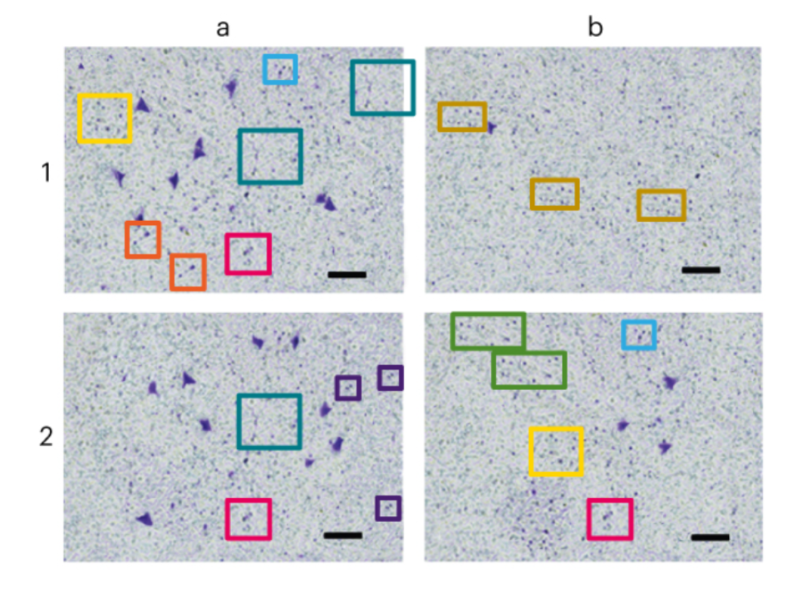
Image Manipulation
Areas enclosed in same-coloured boxes show signs of deliberate duplication
If the images were manipulated, can we still trust the authors’ conclusions?
(Shen, 2020)
Notes:
What the duplicated sections of image tell us is that either a) the images were altered to support a conclusion that the researchers wanted to show, or b) the images were altered somewhere earlier in the process, and the authors formed their conclusions based on looking at the flawed images
Either way: how can we trust the findings when the image used as evidence has been manipulated?
Referenced:
Shen, H. (2020). Meet this super-spotter of duplicated images in science papers. Nature, 581(7807), 132–136. https://doi.org/10.1038/d41586-020-01363-z

Slide 7
Image Manipulation
The paper was ultimately retracted because of Dr. Bik’s findings
Study authors said that the images were generated by a third party company whose involvement was not declared in the initial publication
(Shen, 2020)
Notes:
Referenced:
Editors, T. P. O. (2019). Retraction: Plumbagin Suppresses the Invasion of HER2-Overexpressing Breast Cancer Cells through Inhibition of IKKα-Mediated NF-κB Activation. PLOS ONE, 14(1), e0207273. https://doi.org/10.1371/journal.pone.0207273

Slide 8

Image Manipulation - Dr. Elisabeth Bik
Dr. Bik’s work spotting manipulated figures and images in scientific publications has led to 172 retractions and more than 300 corrections
She and her colleagues have examined >20,000 biomedical publications and found that over 3.8% contain problematic figures, and that numbers of these figures are rising
(Shen, 2020; Bik, 2016)
Notes:
Referenced:
Bik, E. M., Casadevall, A., & Fang, F. C. (2016). The Prevalence of Inappropriate Image Duplication in Biomedical Research Publications. MBio, 7(3), e00809-16. https://doi.org/10.1128/mBio.00809-16
Shen, H. (2020). Meet this super-spotter of duplicated images in science papers. Nature, 581(7807), 132–136. https://doi.org/10.1038/d41586-020-01363-z

Slide 9
Why is this so important?

Slide 10
Images and visualizations are often the best way to communicate our data and insights...
But if we can’t trust that visualizations are representing the ‘real’ data, we can’t trust what their creators are trying to communicate...
So how can we ensure that the visualizations we create are representing our data with integrity?

Slide 11
Reproducibility

Slide 12
What is reproducibility?
Reproducible work is “capable of being checked because the data, code, and methods of analysis are available to other researchers”
That is: someone could repeat the steps we took to generate a particular result or image from our data
The figures in the case study we saw were not reproducible, because they were made by an unknown third party using unclear methods
Reproducibility of data is a hot topic across professional and academic research contexts, and increasingly a requirement for publication
(Allison et al., 2016)
Notes:
Recall: back in 7.1 we talked about substantive qualities of data viz (AKA viz that accurately and honestly present their data); reproducibility is a way of supporting those substantive qualities
Referenced:
National Academies Press. (2019). Understanding Reproducibility and Replicability. In Reproducibility and Replicability in Science. National Academies Press (US). https://www.ncbi.nlm.nih.gov/books/NBK547546/
Allison, D. B., Brown, A. W., George, B. J., & Kaiser, K. A. (2016). Reproducibility: A tragedy of errors. Nature, 530(7588), 27–29. https://doi.org/10.1038/530027a

Slide 13
Reproducibility is ethical
The American Statistical Association’s Ethical Guidelines for Statistical Practice state that “Good statistical practice is fundamentally based on transparent assumptions, reproducible results, and valid interpretations”
Recall from last class that visualizing data means making decisions
Reproducibility helps to hold us accountable for those decisions
(ASA, 2018)
Notes:
Referenced:
Committee on Professional Ethics of the American Statistical Association. (2018). Ethical Guidelines for Statistical Practice. https://www.amstat.org/ASA/Your-Career/Ethical-Guidelines-for-Statistical-Practice.aspx

Slide 14
Reproducibility is practical
Making data visualizations reproducibly is practical as well as ethical:
Makes it easier to make changes if we have to edit a plot or image weeks or months after its creation
Helps us to draw on previous work to make new graphics more easily
Useful for version control because we can easily see where exactly we made changes
(Healy, 2018)
Notes:
Healy 2.1

Slide 15
NOTE:
The ability to reproduce a result does not necessarily indicate correctness, nor does the inability to do so mean a result is incorrect.
But “science is incremental: it is only through transparency and by enabling reproducibility that scientific knowledge evolves.”
(Fekete & Freire, 2020)
Notes:
Reproducibility doesn’t mean that a result is correct, but it does give us the ability to evaluate that correctness for ourselves in a critical, thorough fashion
Referenced:
Fekete, J.-D., & Freire, J. (2020). Exploring Reproducibility in Visualization. IEEE Computer Graphics and Applications, 40(5), 108–119. https://doi.org/10.1109/MCG.2020.3006412

Slide 16
So how can we make our data visualizations reproducible?

Slide 17
Work programmatically
We want to do as much work on our figures as possible programmatically
This means we want to make our images in code (eg. ggplot in R, matplotlib in Python) rather than in programs like Adobe Illustrator, where changes and data sources are harder to trace
(Healy, 2018)
Notes:
Healy 2.1

Slide 18
Work in plain text
Code should be written in a simple, plain-text format (eg. R scripts or .txt files)
Code should not be written in a word processor (eg. Microsoft Word)
Ideally, our ‘pretty’ final products (images, graphs, charts) can be procedurally (and reproducibly!) generated just by running our code
(Healy, 2018)
Notes:
Healy 2.1

Slide 19
Comment your code
When others (or us, at a later date) want to look back at the code we used to make our data visualizations, comments can help us to make sense of what choices were made and why
Comments make code easier to understand, maintain, and update
(Steidl et al., 2013; Healy, 2018)
Notes:
Referenced:
Healy 2.1
Steidl, D., Hummel, B., & Juergens, E. (2013). Quality analysis of source code comments. 2013 21st International Conference on Program Comprehension (ICPC), 83–92. https://doi.org/10.1109/ICPC.2013.6613836

Slide 20
Activity: Comment our code
Let’s return to our saved code from practicing making a plot in Python using matplotlib
We can add comments to our code by preceding them with ‘#’ OR by using markdown cells (in Jupyter Notebooks)
Take a few minutes to comment your code, and then return and discuss what you did
What information is it helpful to include?
How do you write a ‘good’ comment?

Slide 21
Datasheets for datasets
Gebru et al. (2020) propose that datasets be accompanied by a datasheet that “documents its motivation, composition, collection process, recommended uses”, etc
Datasheets can facilitate connections between the underlying data and the final analytical products (in our case, images and figures)
(Gebru et al., 2018)
Notes:
Referenced:
Gebru, T., Morgenstern, J., Vecchione, B., Vaughan, J. W., Wallach, H., Daumé III, H., & Crawford, K. (2020). Datasheets for Datasets. ArXiv:1803.09010 [Cs]. http://arxiv.org/abs/1803.09010

Slide 22
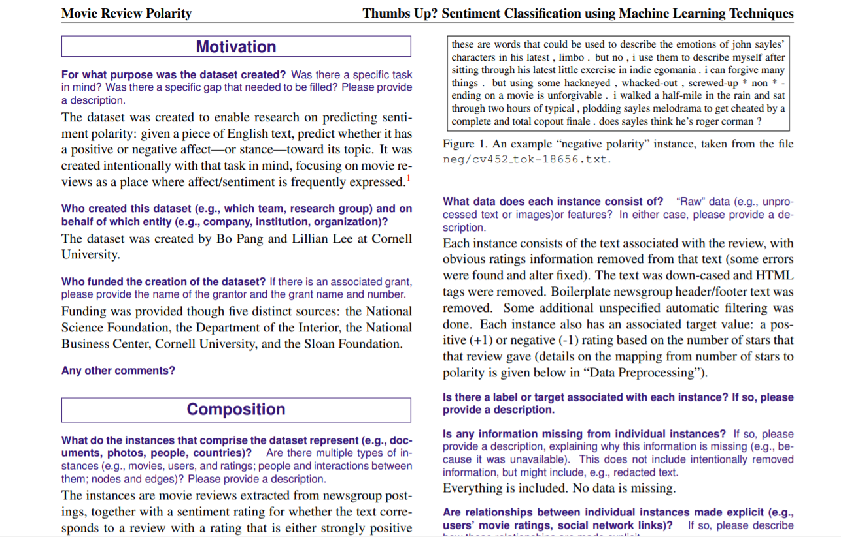
Datasheets for datasets - Sample datasheet
(Gebru et al., 2018)
Notes:
NOTES:
Follow the hyperlink to the gebru paper and scroll, walk through the example datasheet in more detail and discuss useful elements
Referenced:
Gebru, T., Morgenstern, J., Vecchione, B., Vaughan, J. W., Wallach, H., Daumé III, H., & Crawford, K. (2020). Datasheets for Datasets. ArXiv:1803.09010 [Cs]. http://arxiv.org/abs/1803.09010

Slide 23
Next...
Customizing our plots
Adding legends
Annotating our plots
Working with colour
Pre-made styles
Choosing the right graph for a given situation (Professional skills)

